Slide 1
Veni - A Check-In Mobile App for Veterans
UTD EMSE Spring 2015
April 22nd Class Meeting Report
Anant Kambli Brian MacKay Raleigh Murráy Shahed Shuman Kathryn Whitmire

Slide 2
Review
Recent news articles have documented the problems Veterans have had utilizing the medical benefits they have earned in combat
One obstacle to veterans in VA medical facilities is the check-in process
It’s characterized by long line-ups to check in and receive directions to their appointment
This application aims to streamline that process
Moving the checkin process away from the facility and to the patient using a mobile application on his or her smartphone

Slide 3
High Level Architecture
The high-level architecture remains
A VistA system (or systems)
Dev-sandboxed VistA system in a cloud VM for this project
A middle tier web-service application running in a cloud VM
A phone application that includes logic and UI but no data
We are using a “write once – target all” development environment
The phone app will use the phone’s location services and calendar
See System Architecture Document
Package layer diagram, component diagram, top level class diagram

Slide 4
A Little UML: A Package Diagram
AWS Cloud

Slide 5
The Physical Architecture – Initial Concept
Linux Virtual Machine
VA Data Center
VA Data Center
Veni-Specific VistA Instance
Sandboxed Dev VistA Instance
Production VistA Instance
Java Remoting
Linux Virtual Machine
Gateway Java – J2EE
REST - via HTTPS
with JSON or XML
iOS
Android
Xamarin or Apache Cordova

Slide 6
The Physical Architecture Now
Linux Virtual Machine
Veni-Specific VistA Instance
Remoting
Virtual Machine
Web Service
REST - via HTTPS
with JSON or XML
iOS
Android
Intel, Xamarin or Apache Cordova

Slide 7
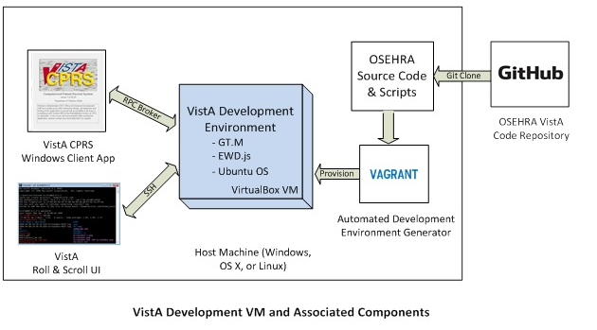
Setting Up Dev-Sandboxed VistA System
Using directions from: http://www.osehra.org/content/how-setup-osehra-vista-development-virtual-machine-vm-0

Slide 8
The View from the Cloud
AWS Cloud
VistA Linux
Mumps
EWD.js
HTTPS
/ 443
AWS RDB Windows
SQL Server
HTTPS
/ 443
MS-SQL
/ 1433
Veni Middle Tier Windows/ASP.NET/WebAPI
MS-SQL
/ 1433
HTTPS
/ 443
MS-RDP
/ 3389
Smart Phone
Admin
Terminal Specific IP Address

Slide 9
RESTful Nirvana?
All services use plain-old JSON to represent the state being transferred
Everything is fully stateless
Only server-side state is authentication session – described by an opaque token
State described as resources and collections of resources
Out of band information in HTTP headers
Queries to narrow state selection passed in query-strings
Access by standard HTTP verbs: GET, POST, PUT, DELETE
Use of hypermedia links where appropriate

Slide 10
Security Analysis
Required to protect PHI and PII
Cloud Security – Security Groups
Veni Application Server Security Group
Veni Database Server Security Group
VistA System Security Group
Security Tools
TSL – encrypt communications and provides authenitication of server to client
Only save salted password cryptographic hashes
Opaque Tokens

Slide 11
Security Analysis
Design Principles
Separation of Duties
Least Privilege
Unsuccessful Logon Attempts
System Use Notification
Previous Logon (Access) Notification
Concurrent Session Control
Session Termination
Access Control for Mobile Devices
Non-Repudiation

Slide 12
Primary Use Case: Check-in at VA Facility
<<include>>
<<include>>

Slide 13
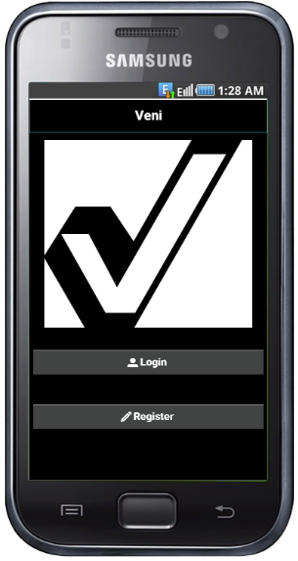
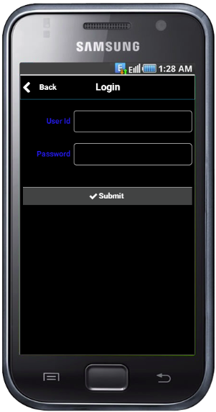
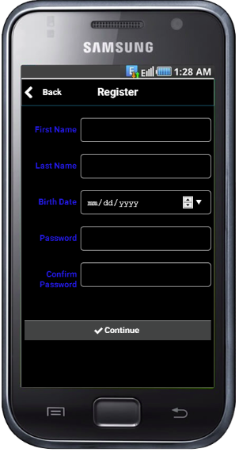
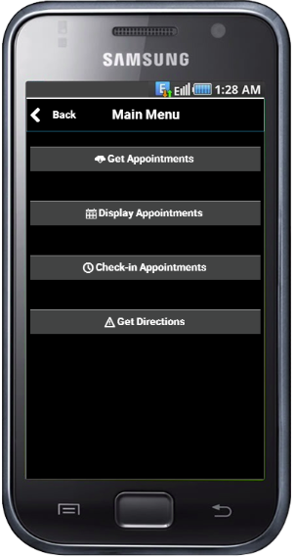
Phone Screens from UI Prototype
Splash Screen
Logon Screen
Register User
Main Menu

Slide 14
Prototype Demonstration

